Slide 1
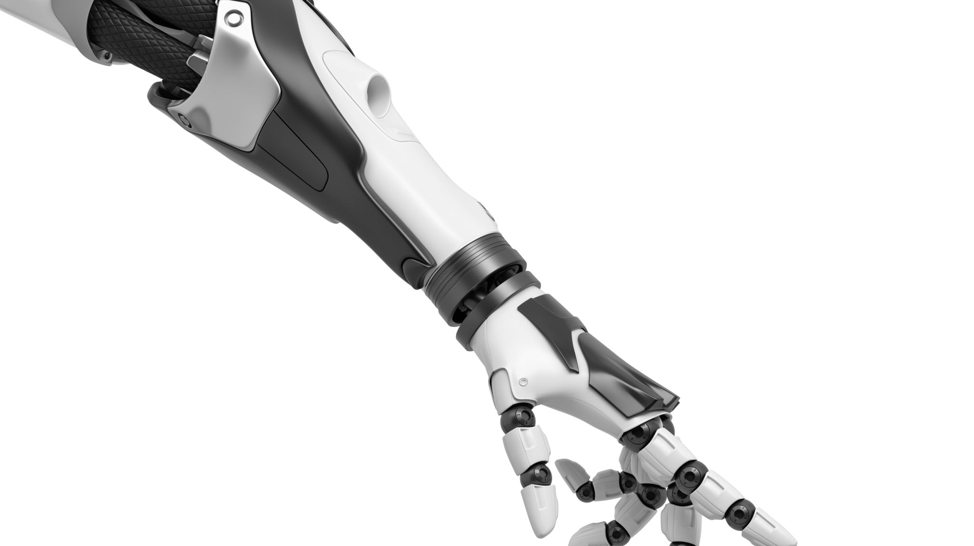
History of Artificial Intelligence

Slide 2
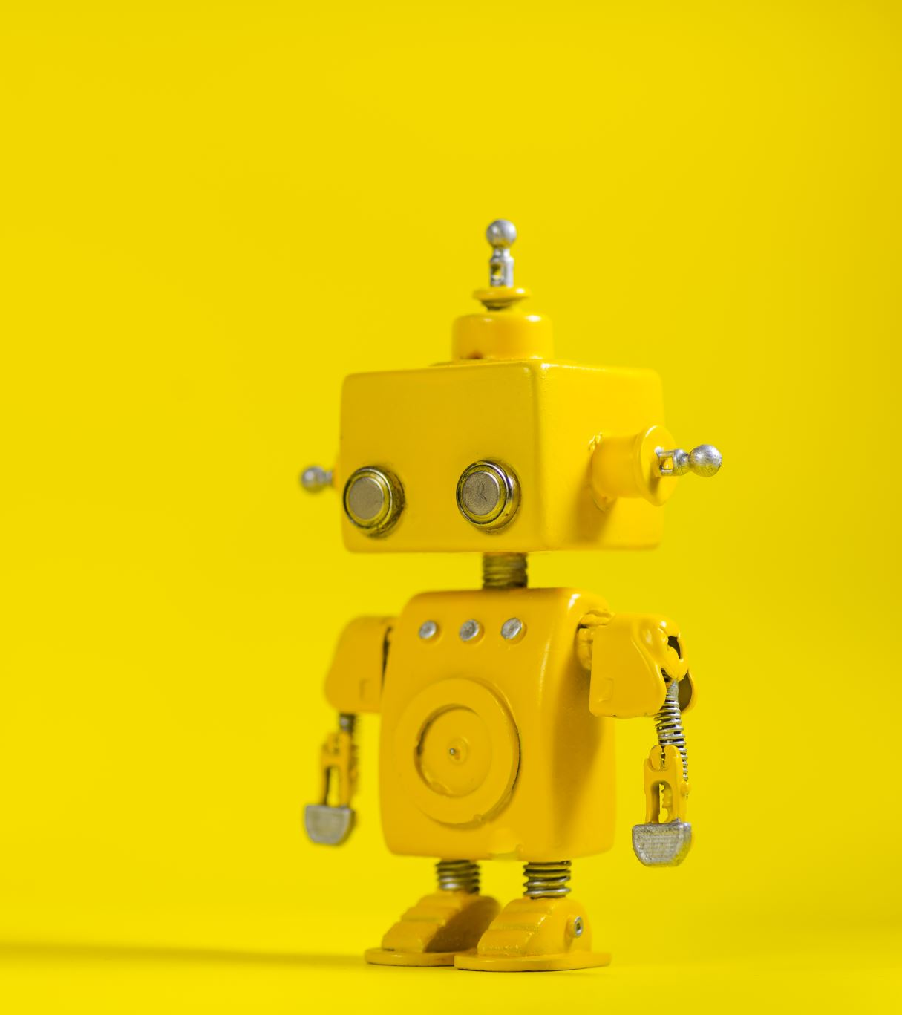
What is artificial intelligence
Systems or devices that mimic human intelligence to perform tasks and that can improve themselves based on the information they gather.

Slide 3
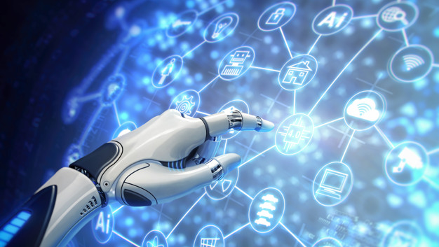
HISTORY OF ARTIFICIAL INTELLIGENCE
Few scientists began discovering new ways to build smart machines in the middle of the twentieth century.
On the campus of Dar Tamot College in 1956, a conference was held in which a modern field of artificial intelligence research was established.
At the beginning of the sixties, this research became generously funded by the Department of Defense in the United States of America.
In the early eighties, the new awakening of artificial intelligence research was when expert systems excelled and succeeded resoundingly.
In the 1990s and the beginning of the twenty-first century, science achieved greater success, as artificial intelligence was used in logistics, medical diagnostics, medical laboratories, data mining, and various technological fields and industries.

Slide 4
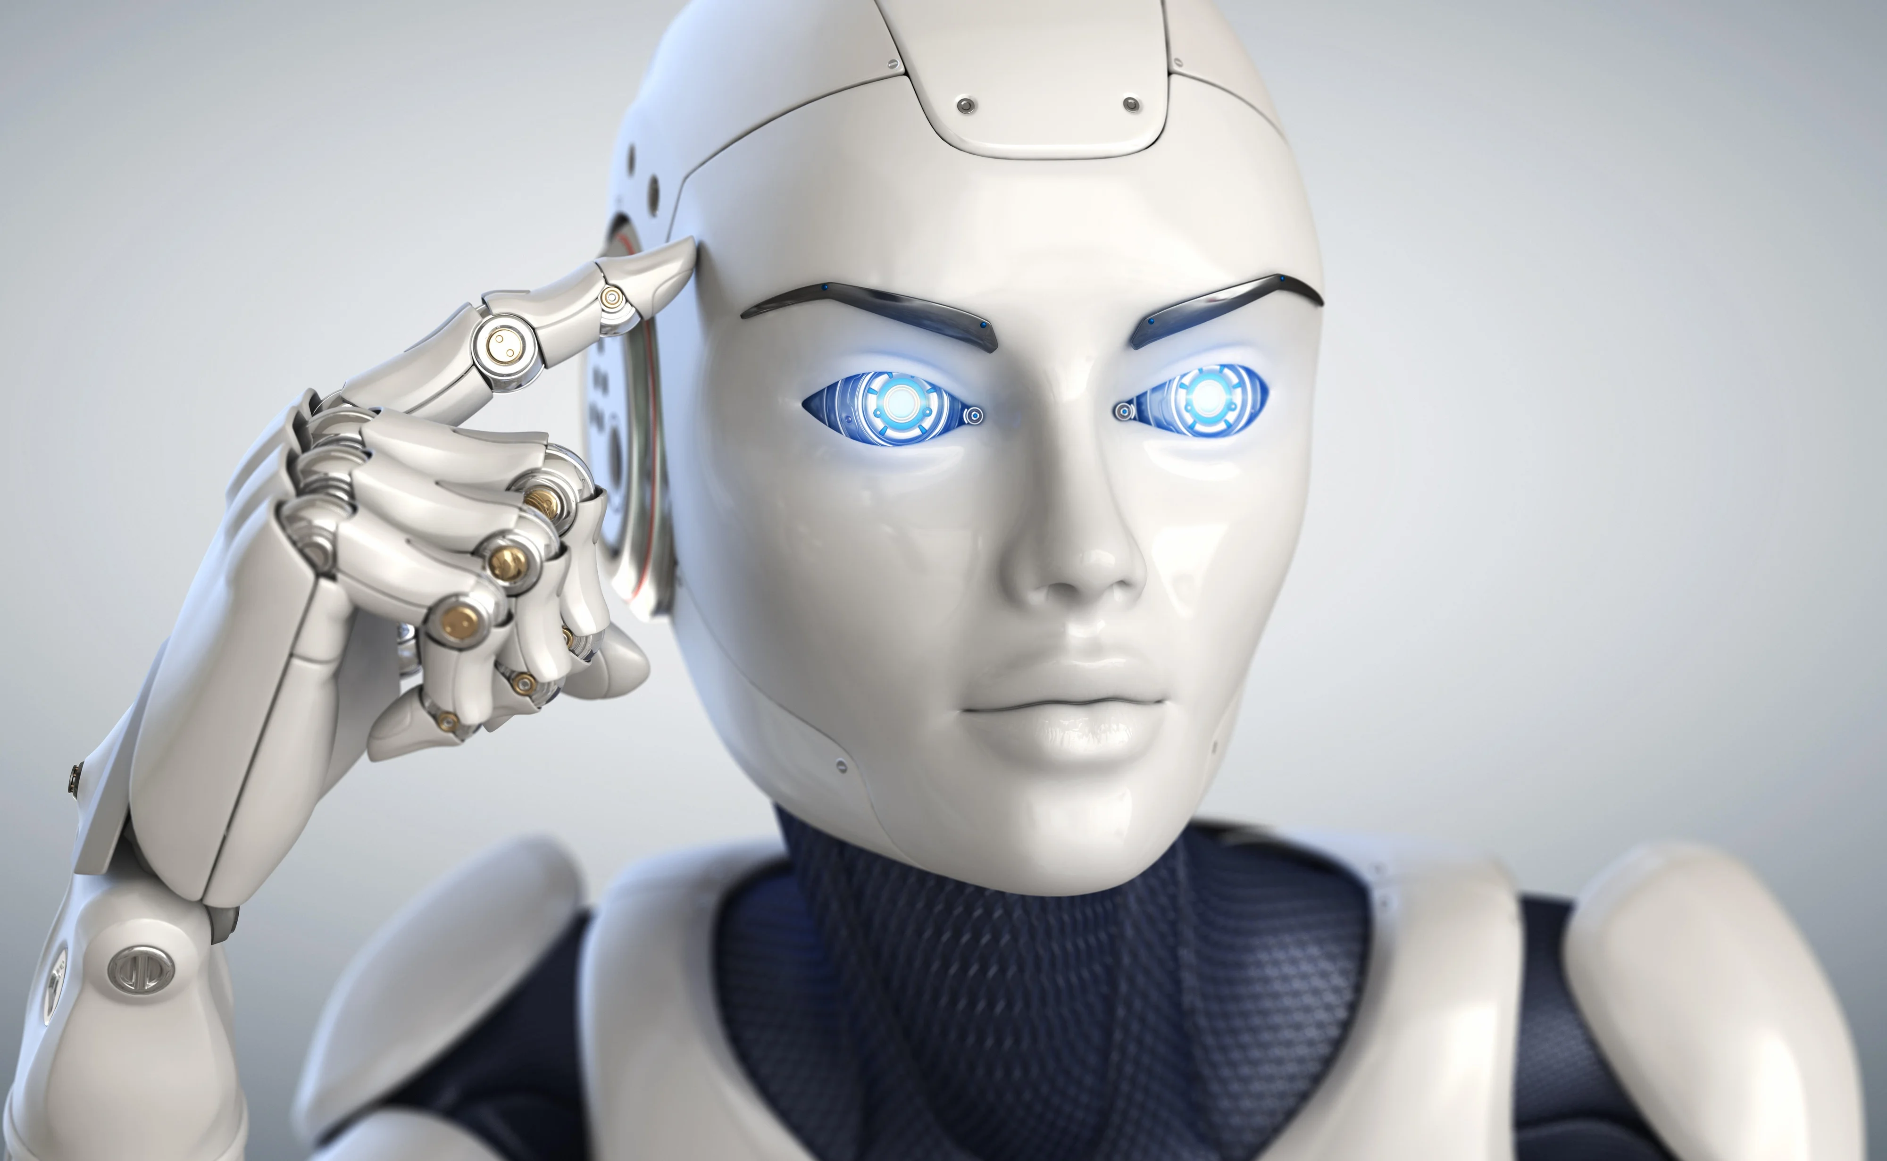
THANK YOU FOR LISTENING

